Slide 1
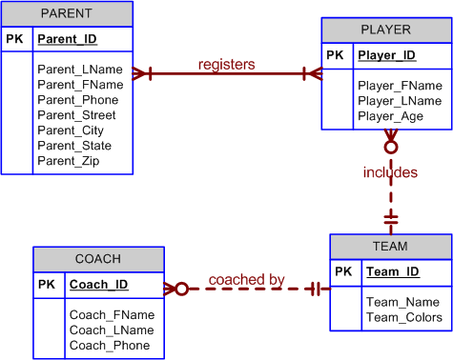
Conceptual ERD prior to removal of Many to Many relationship between player and parent. Foreign Keys not shown
A coach may not have a team – optionality – use dotted line)

Slide 2
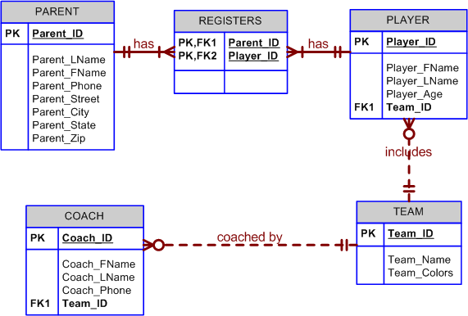
M:N resolved for Parent: Player. Bridging Entity: Registers introduced. Foreign Keys Shown . In the Registers Entity the Primary key is composite (PARENT_ID+PLAYER_ID) and each of these is also a Foreign Key. Registers participates in 2 Strong relationships
Parents appears in Registers. Registers include Parent
Registers includes Player. Players appear in registers
Not Null FK1 value implements the must have condition

